Slide 1
CREDIT EDA CASE STUDY
‘If you torture the data enough, it will confess to anything’
-Ronald Coase
British Economist & Author

Slide 2

CURRENT APPLICATION
ANALYSIS

Slide 3
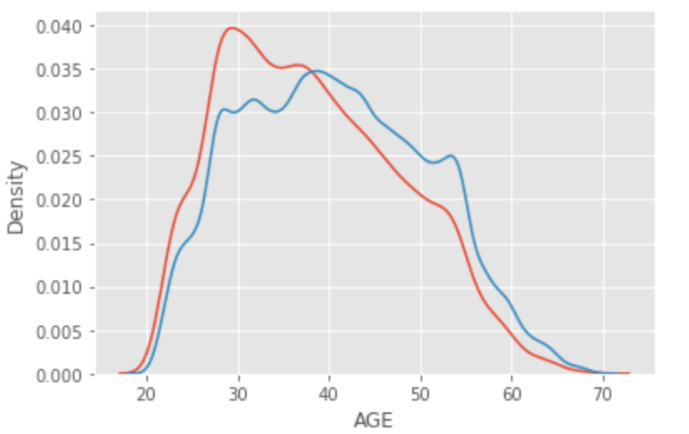
Univariate - Continuous Analysis for different age groups in both Defaulters and Regulars
Age group of both defaulters and regulars has a uniform distribution and maximum range of age ranging from 25 to 55
Age group from 25 to 35 in most cases have steady income and a family (either parents or wife) and are more keen on taking up loans for housing, education, personal purposes and automobiles.

Slide 4
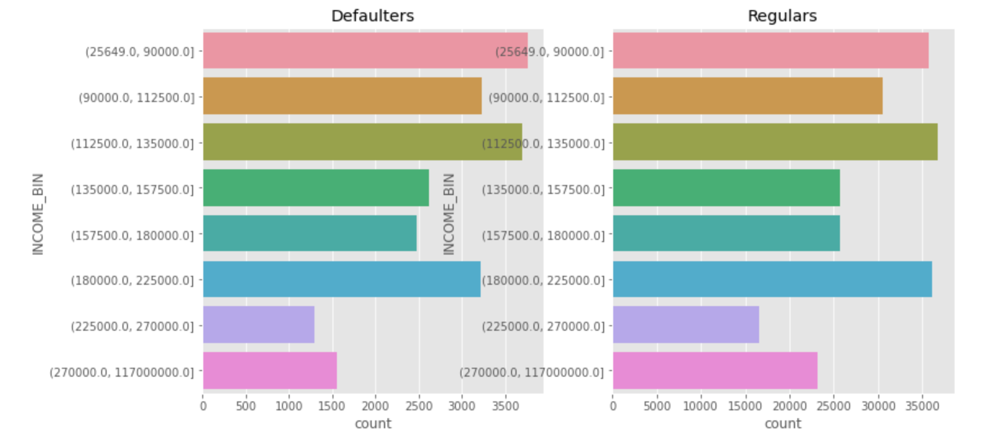
Univariate - Categorical Analysis for Income range in both Defaulters and Regulars
Income range of defaulters seems to be lesser when compared with regulars, however count of regular people are higher

Slide 5
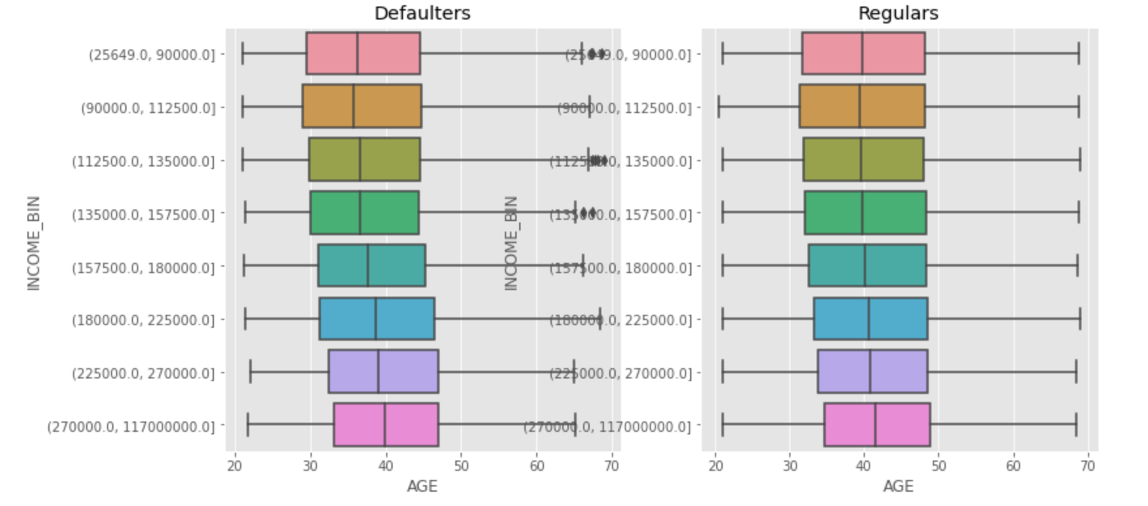
Bivariate - Count as per Categorical Analysis for Income range with comparison to Age groups
Range of Income bin with age
25th and 75th percentile ranging of defaulters ranging 35-48 and regulars 35-50 whereas median of defaulter are seemingly ranging less than or equal to 40, regulars median ranging above 40
Defaulters has some outlier values where as regulars are having uniform age distribution

Slide 6
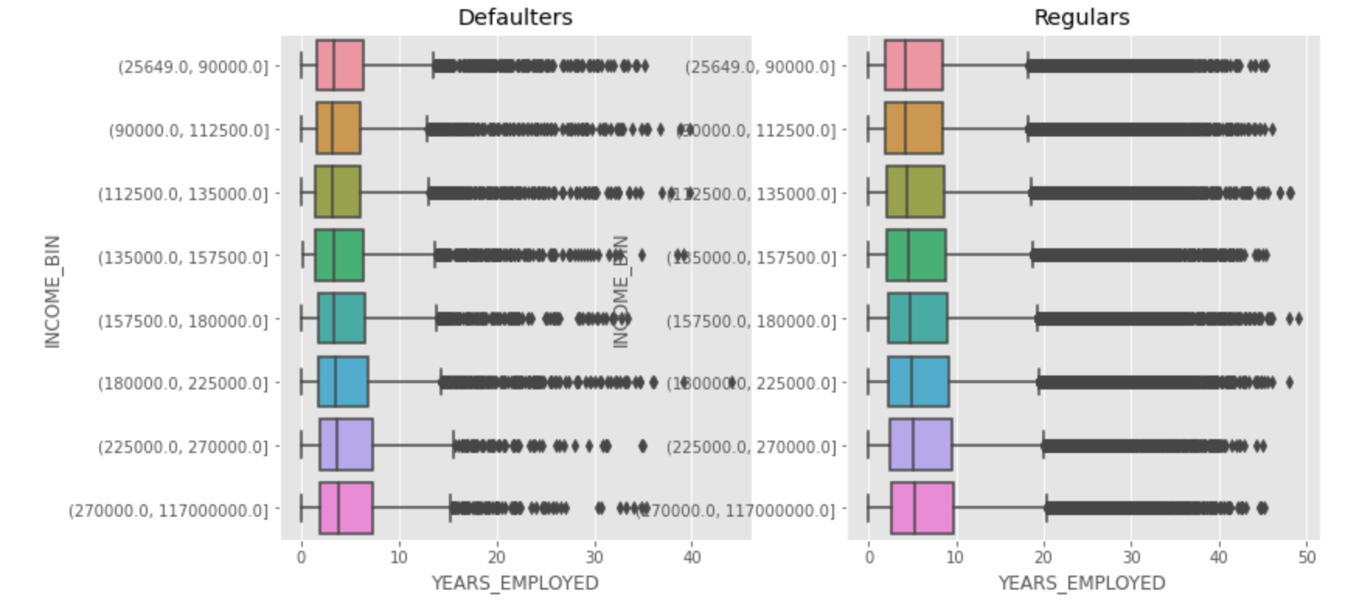
Bivariate - Count of Categorical Analysis for Income range with comparison to Years of Employment
Range of Income bin with years employed - Outliers
Outliers range in defaulters starts with 13 years whereas regulars starts with 20 years

Slide 7
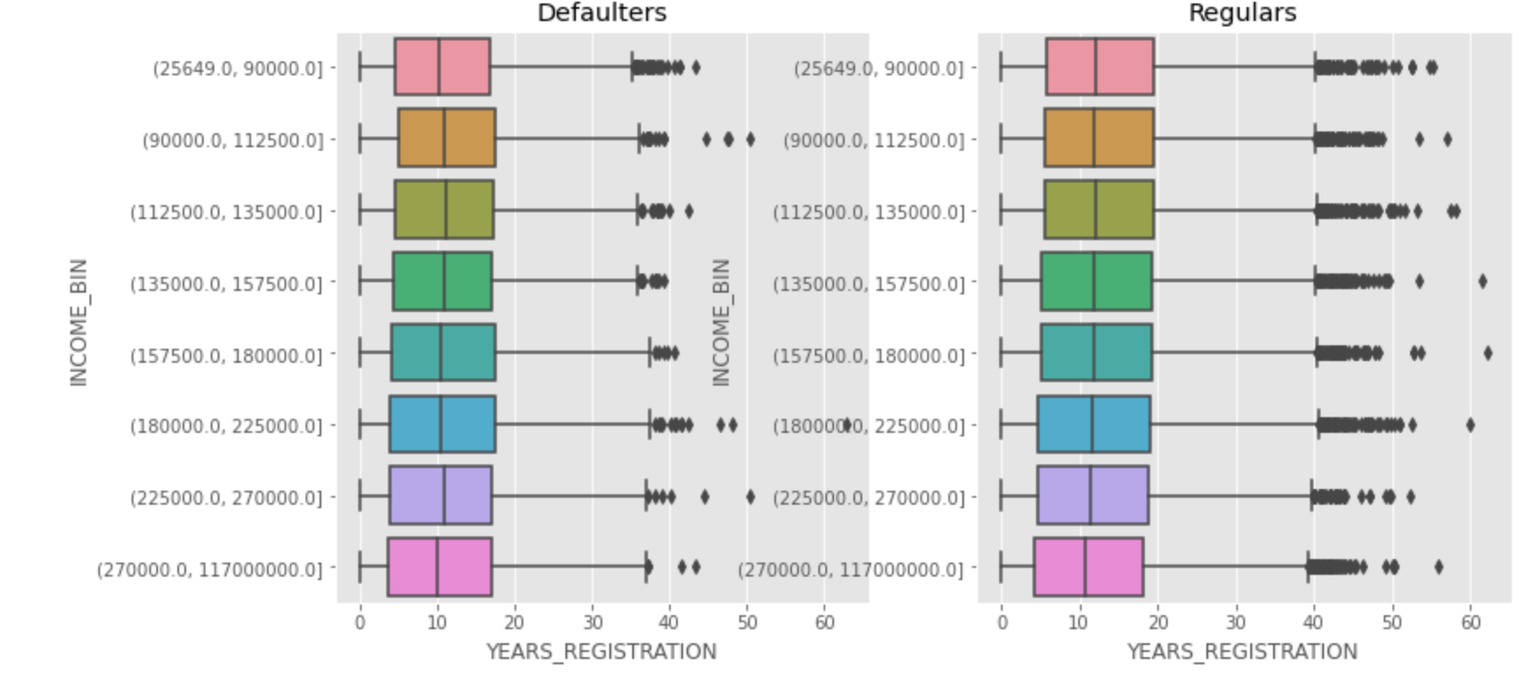
Bivariate - Count of Categorical Analysis for Income range with Client’s Years of Registration
Range of Income bin with years registered - Outliers
Outliers range in defaulters starts with 13 years whereas regulars starts with 20 years of registered client's

Slide 8
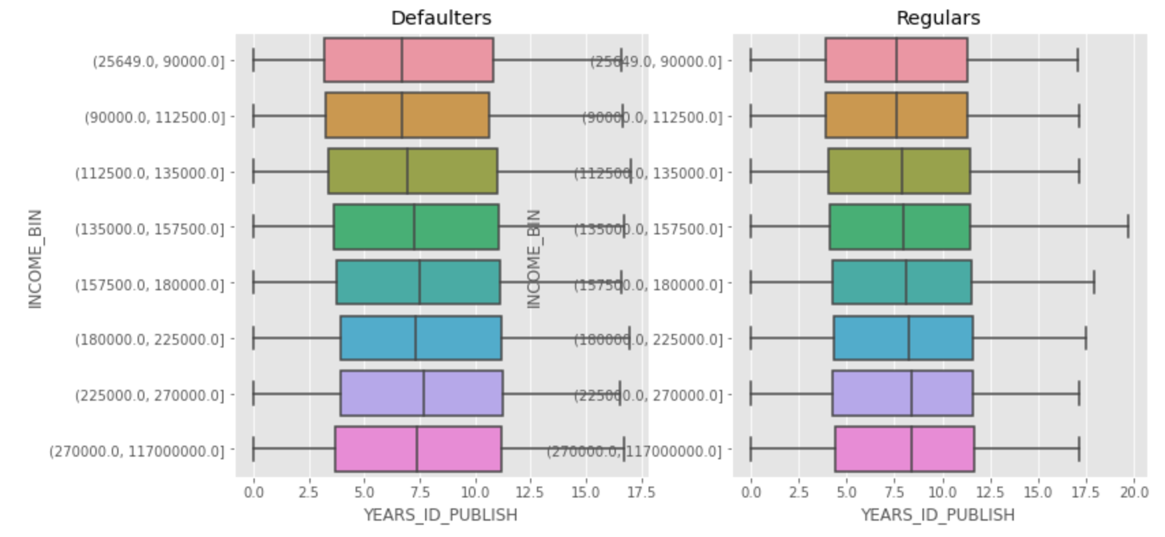
Bivariate - Count of Categorical Analysis for Income range with Client's change in ID
Range of Income bin with years changed ID of client
Median of defaulters starts with 7.5 years whereas regulars are more than 7.5 with median value after the client has changed his ID during the time of application

Slide 9
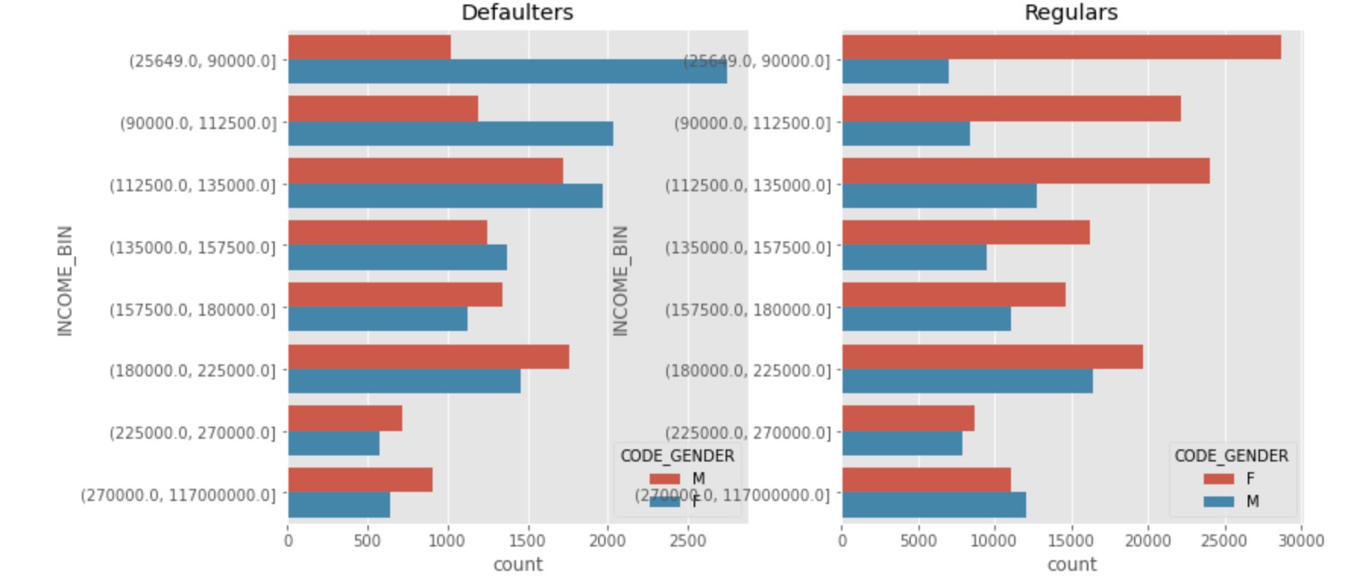
Univariate - Categorical Analysis of Income range for both Defaulters and Regulars with Hue Gender Category
Gender range of defaulters vs. regulars with Income
No of Female clients tops the income range when compared with male in both defaulters as well as regulars group, however the salary range of male defaulters increases gradually when compared with female defaulter clients

Slide 10
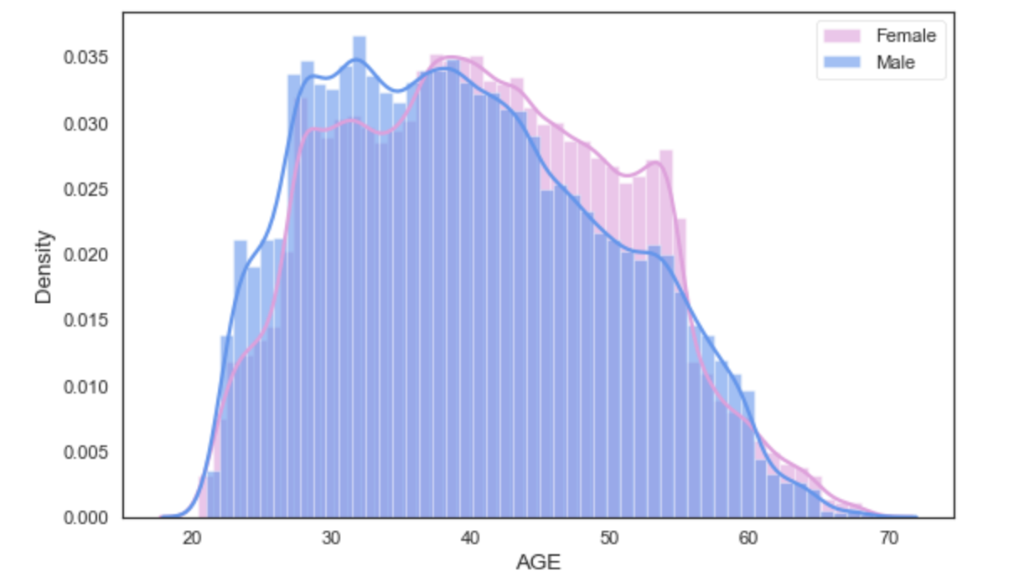
Distribution of Client’s Age with Gender
Age group of both male and female has a uniform distribution and maximum range of age ranging from 28 to 54

Slide 11
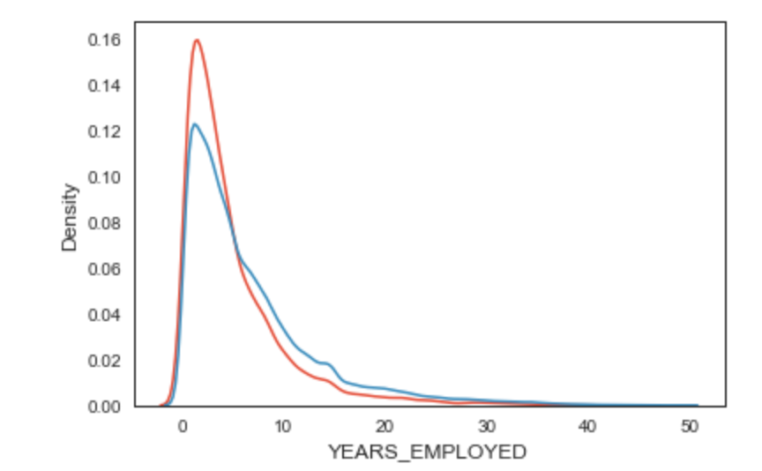
Univariate - Continuous Analysis for Years of Employment for both Defaulters and Regulars
Years employed of both defaulters and regulars has a non-uniform distribution and maximum range of years ranging from 0 to 10
There are possibilities of people who are (Students) apply for loan for education

Slide 12
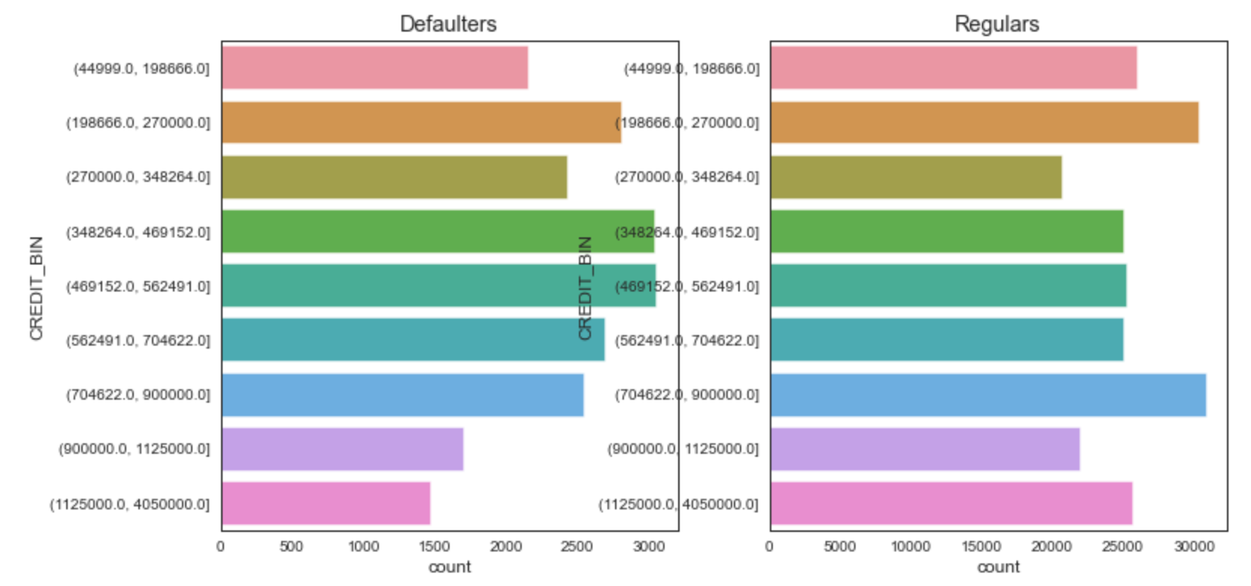
Univariate - Categorical Analysis for Credit range in both Defaulters and Regulars
Credit range 350000 - 560000 of defaulters seems to be higher whereas regulars with higher credit range of 700000 - 900000 tops, where count of regular people are higher than the defaulters

Slide 13
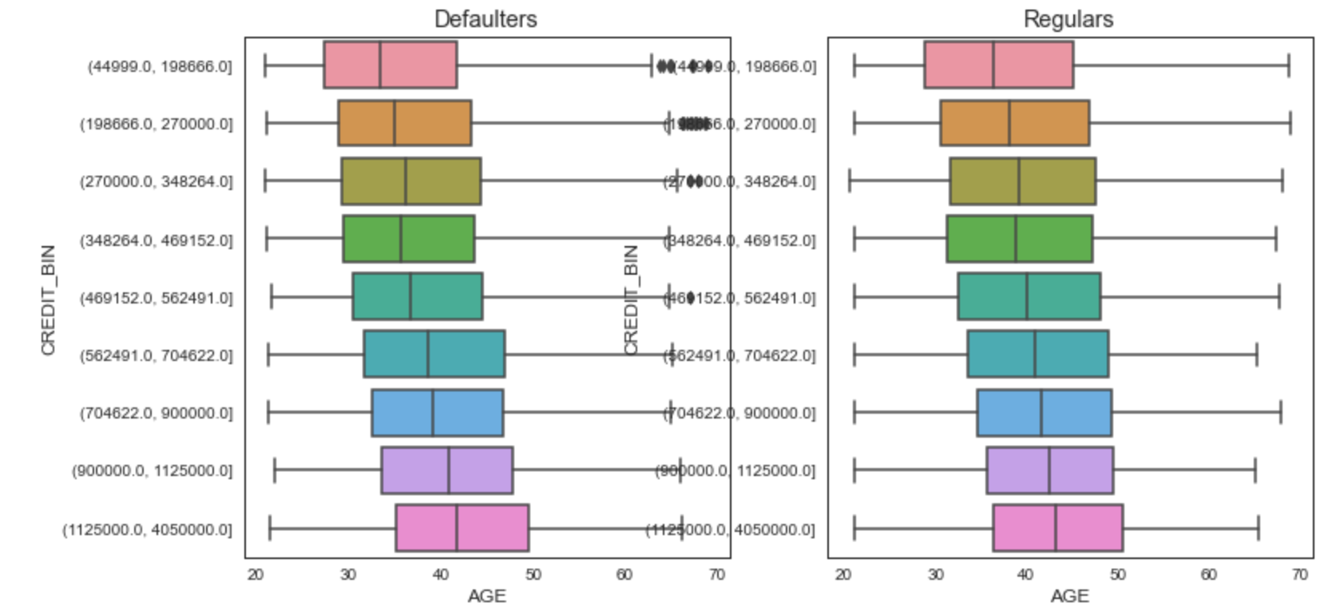
Bivariate - Count of Categorical Analysis for Credit range with comparison to various Age Groups
Range of Credit bin with age
25th and 75th percentile ranging of defaulters ranging 35-50 and regulars 38-50 whereas median of defaulter are seemingly ranging in 35-40, regulars median ranging 40 and above
Defaulters has some outlier values where as regulars are having uniform age distribution

Slide 14
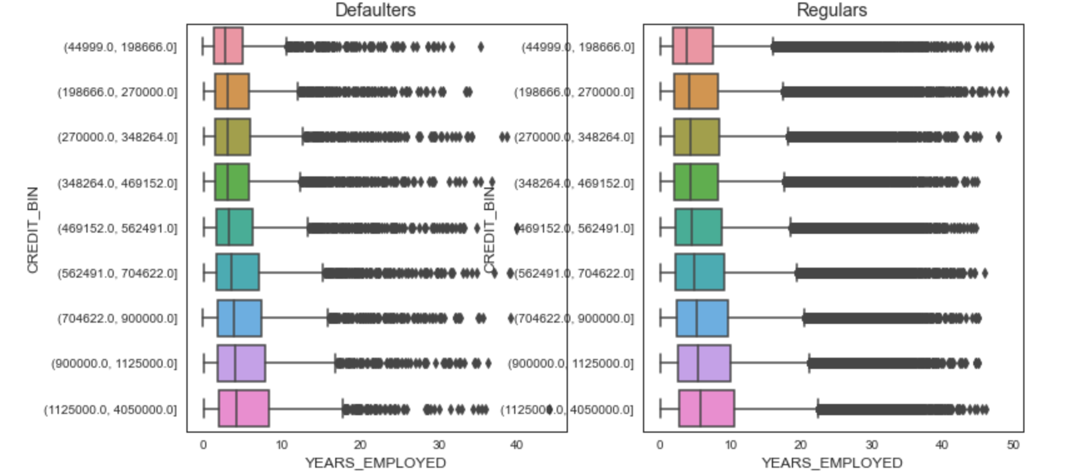
Bivariate - Count of categorical Analysis for Credit range with comparison to Years of Employment
Range of Credit bin with years employed - Outliers
Outliers range in defaulters starts with 11 years whereas regulars starts with 20 years

Slide 15
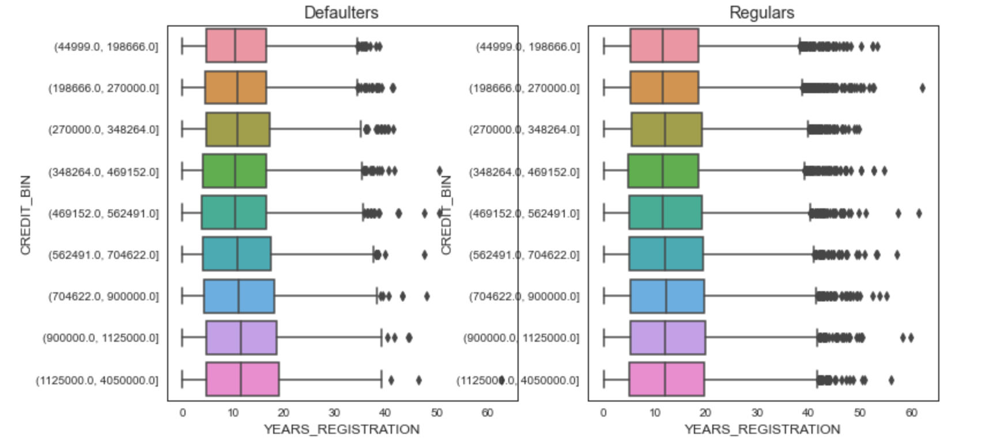
Bivariate - Count of Categorical Analysis for Credit range with Client’s Years of Registration
Range of Credit bin with years registered - Outliers
Outliers range in defaulters starts with 35 years whereas regulars starts with 40 years of registered client's

Slide 16
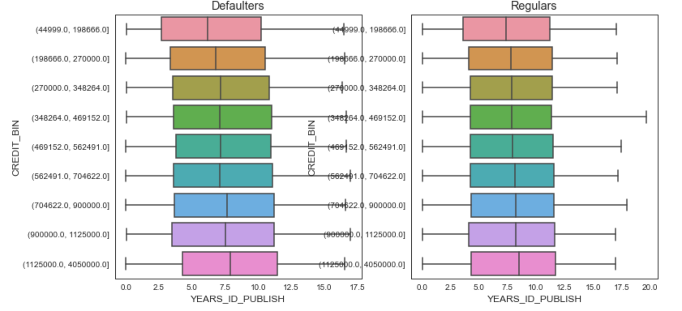
Bivariate - Count of Categorical Analysis for Credit range with Client's change in ID
Range of Credit bin with years changed ID of client
Median of defaulters starts with 7.5 years whereas regulars are more than 7.5 with median value after the client has changed his ID during the time of application

Slide 17
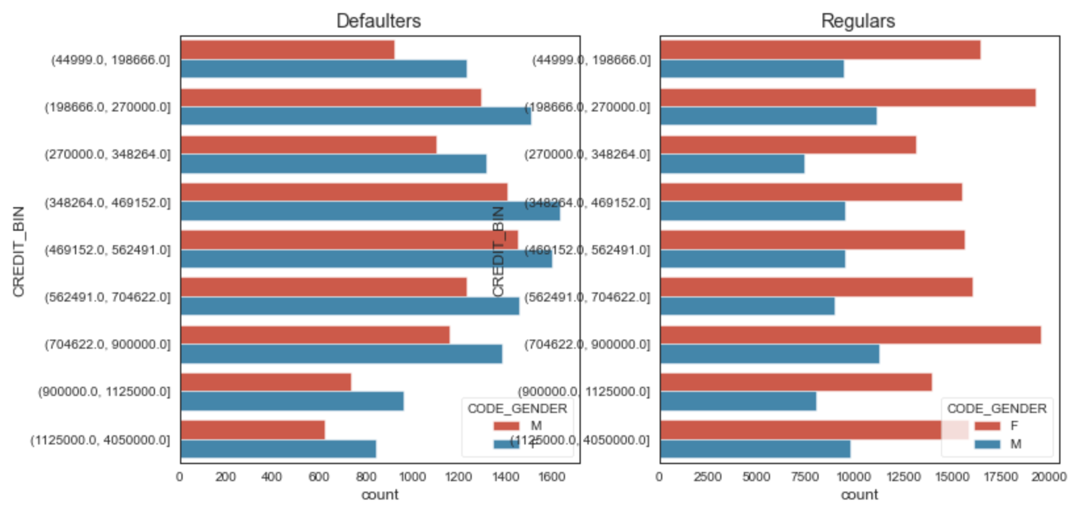
Univariate - Categorical Analysis for Credit range in both Defaulters and Regulars with Hue Gender Category
Gender range of defaulters vs. regulars with Credit
No of Female clients tops the credit range when compared with male in both defaulters as well as regulars group, however there is major difference in regular group of female and male category where female regular clients are higher in ratio than the male regular clients

Slide 18
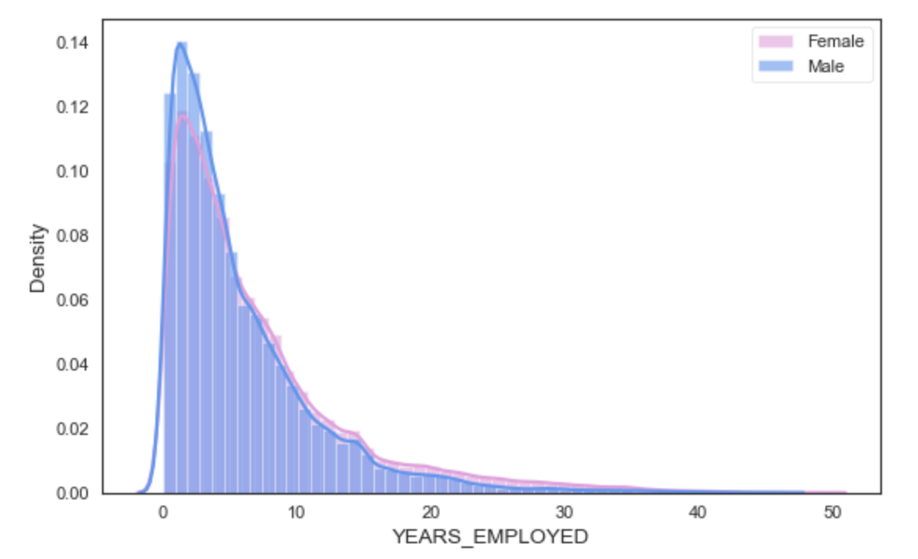
Distribution of Client’s Years of Employment with Gender
Years employed of both male and female has a non-uniform distribution and maximum range of years ranging from 0 to 10
There are possibilities of people who are (Students) apply for loan for education

Slide 19
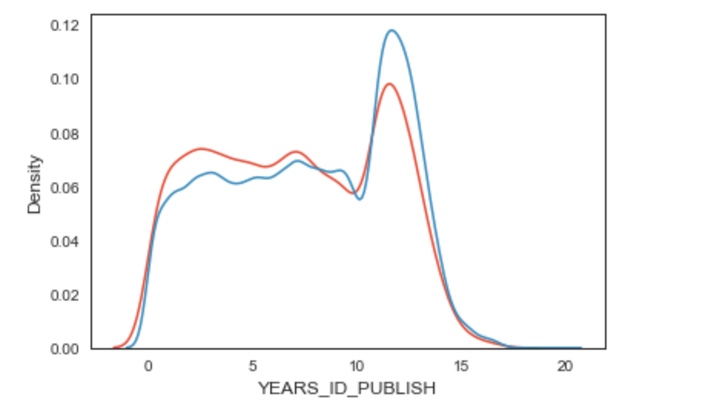
Univariate - Continuous Analysis for Clients who changed ID’s years before the application in both Defaulters and Regulars
Year of change in client ID of both defaulters and regulars has a non-uniform distribution and maximum range of years ranging from 10 to 15

Slide 20
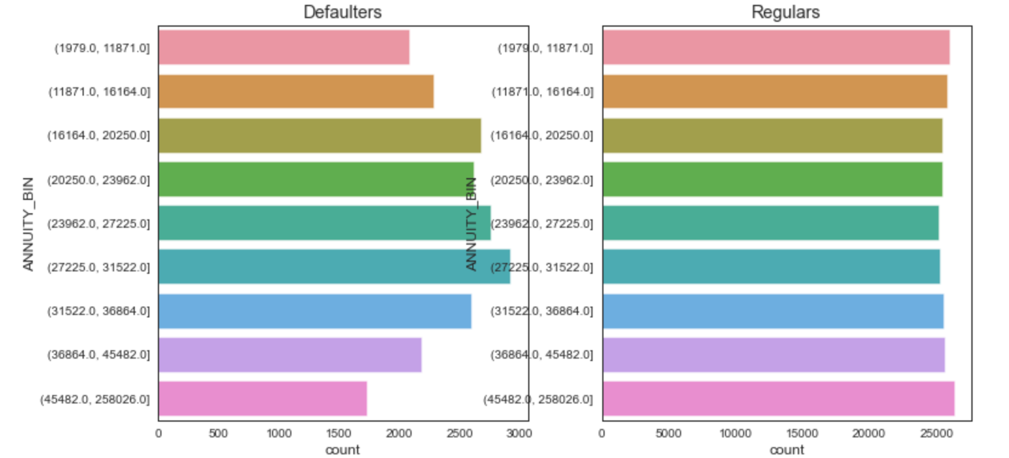
Univariate - Categorical Analysis for Loan Annuity range in both Defaulters and Regulars
Annuity range 27000 - 31000 of defaulters seems to be higher whereas regulars has almost same frequency of annuity range with count of regular people higher than the defaulters

Slide 21
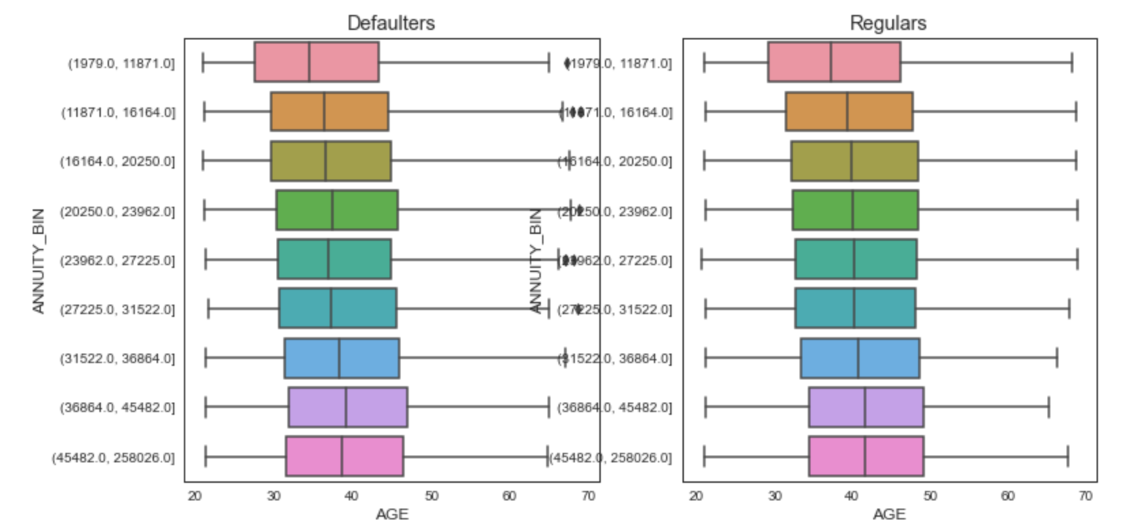
Bivariate - Count Vs Categorical Analysis for Loan Annuity range when compared to Age Group
Range of Annuity bin with age
25th and 75th percentile ranging of defaulters ranging 31-46 and regulars 33-50 whereas median of defaulter are seemingly ranging in 35-40, regulars median ranging 40 and above
Defaulters has some outlier values where as regulars are having uniform age distribution

Slide 22
Bivariate - Count Vs Categorical Analysis for Loan Annuity range when compared to Years of Employment
Range of Annuity bin with years employed - Outliers
Outliers range in defaulters starts with 13 years whereas regulars starts with 20 years

Slide 23
Bivariate - Count Vs Categorical Analysis for Loan Annuity range in comparison to Client’s Years of Registration
Range of Annuity bin with years registered - Outliers
Outliers range in defaulters starts with 35 years whereas regulars starts with 40 years of registered client's

Slide 24
Bivariate - Count Vs Categorical Analysis for Credit range with Client's change in ID
Range of Annuity bin with years changed ID of client
Median of defaulters starts with 7.5 years whereas regulars are more than 7.5 with median value after the client has changed his ID during the time of application

Slide 25
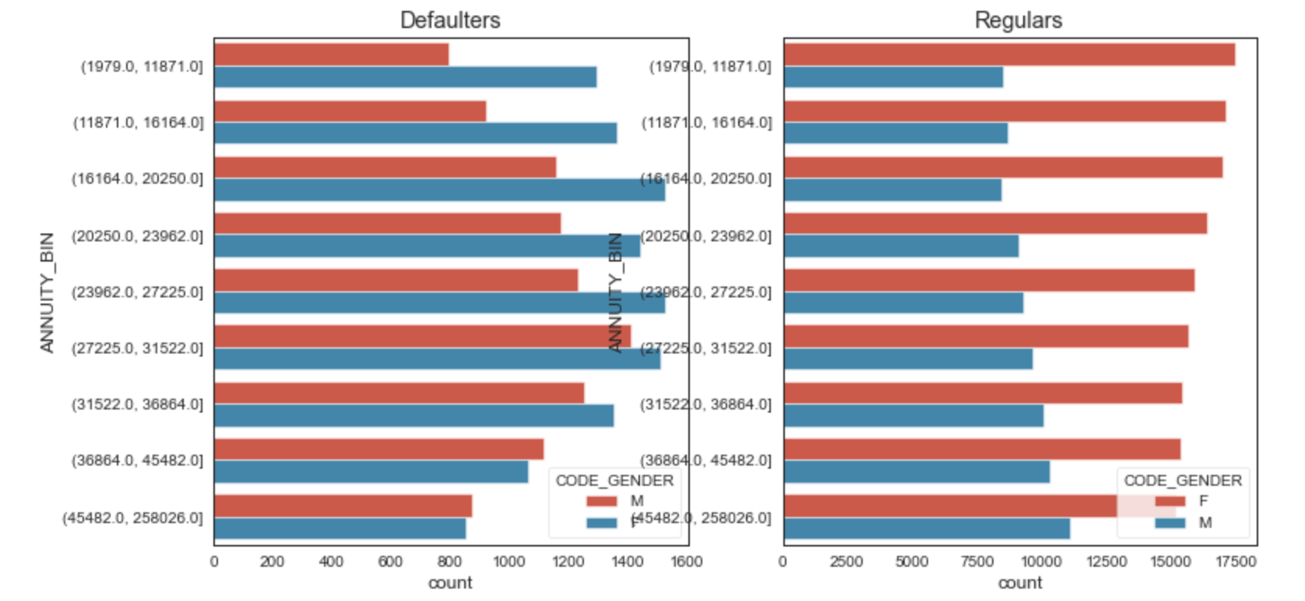
Univariate - Categorical for Loan Annuity range in both Defaulters and Regulars with Hue Gender Category
Gender range of defaulters vs. regulars with Annuity
No of Female clients tops the annuity range when compared with male in both defaulters as well as regulars group, however there is major difference in regular group of female and male category where female regular clients are higher in ratio than the male regular clients

Slide 26
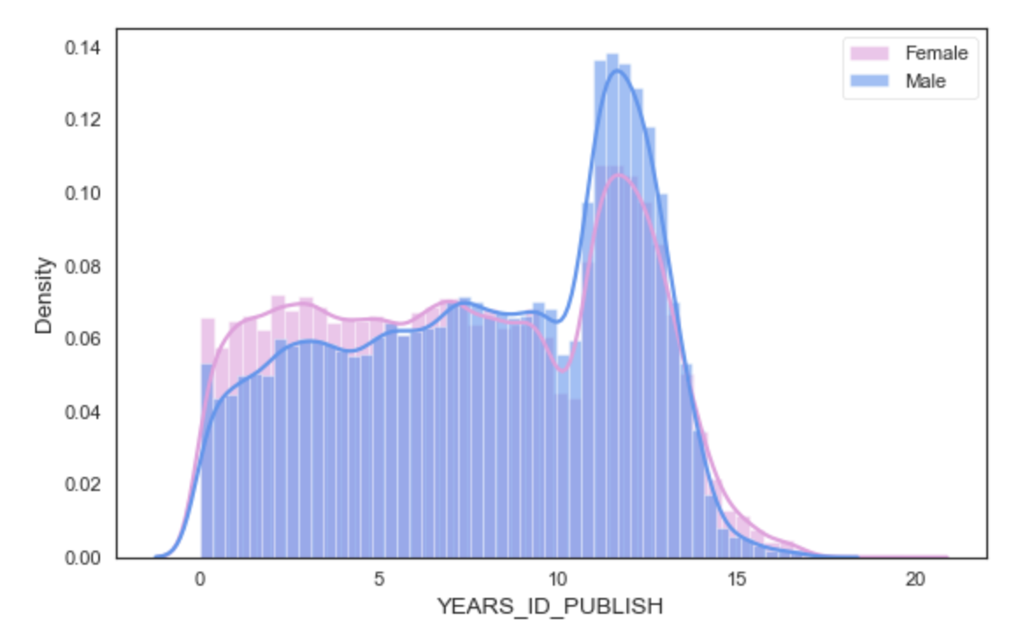
Distribution of Clients who changed IDs years before the application in comparison to Genders
Year of change in client ID of both male and female has a non-uniform distribution and maximum range of years ranging from 10 to 15

Slide 27
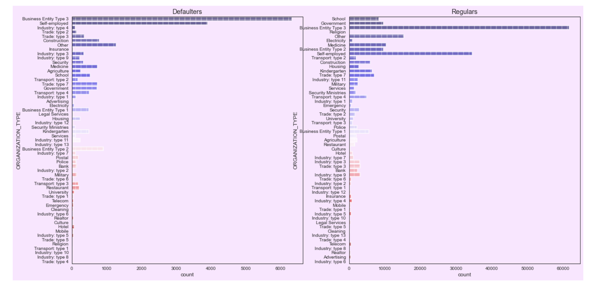
Univariate - Categorical Analysis for Organization Type Categories of both Defaulters and Regulars
ORGANIZATION_TYPE tops with values of Business Entity Type 3 and Self-employed in both the categories Defaulters and Regulars
Most of the client's who are doing business or making small scale investments are in need of loan and this inference clearly shows the same.

Slide 28
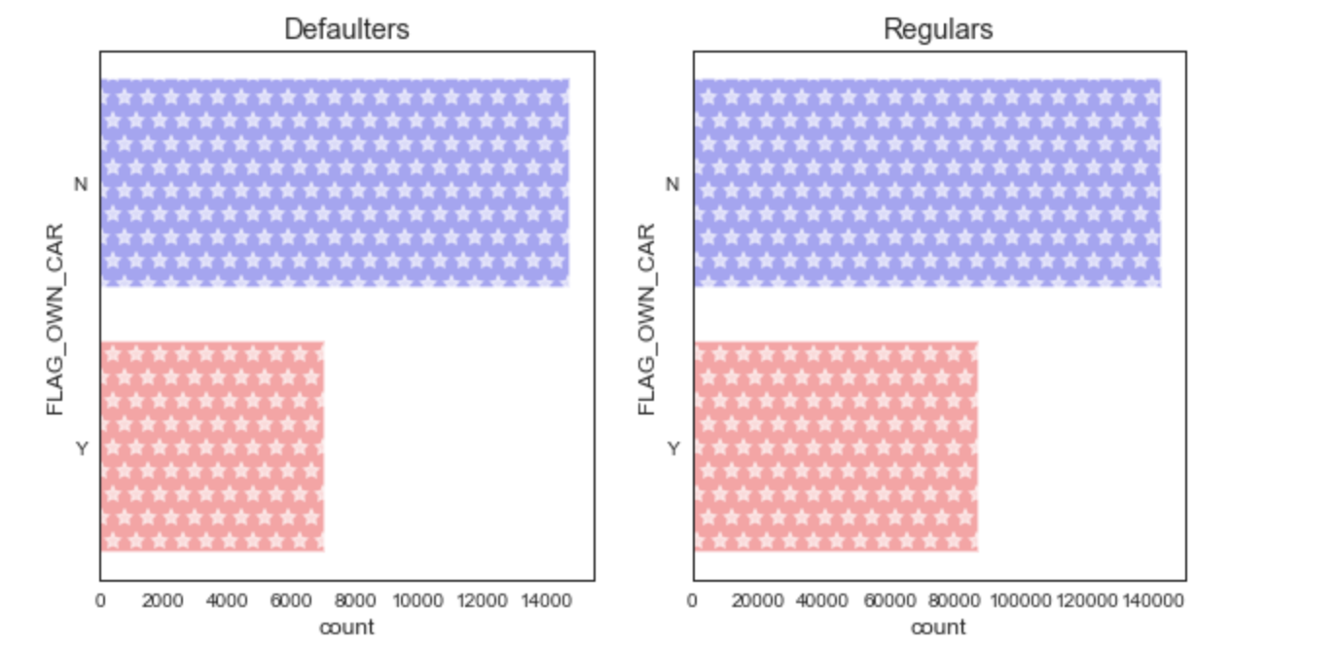
Univariate - Categorical Analysis for Clients with own Car for both Defaulters and Regulars
In both Defaulters and Regulars the clients who own a car are most likely to earn well and the Defaulter count is less than Regulars count

Slide 29
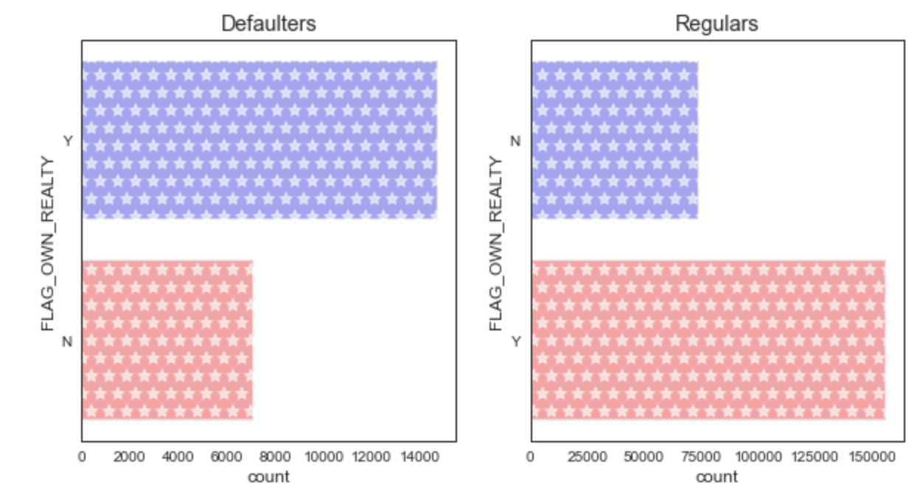
Univariate - Categorical Analysis for Clients with own House or Flat for both Defaulters and Regulars
In Regulars the clients who own an apartment/flat are most likely to earn well and they fall under the category of Regulars due to the documents of REALTY they would have submitted during loan application also Regulars are majority in numbers
This major inference makes a clarity that if any client ready to produce/pledge document related to their realty they can be granted loan

Slide 30
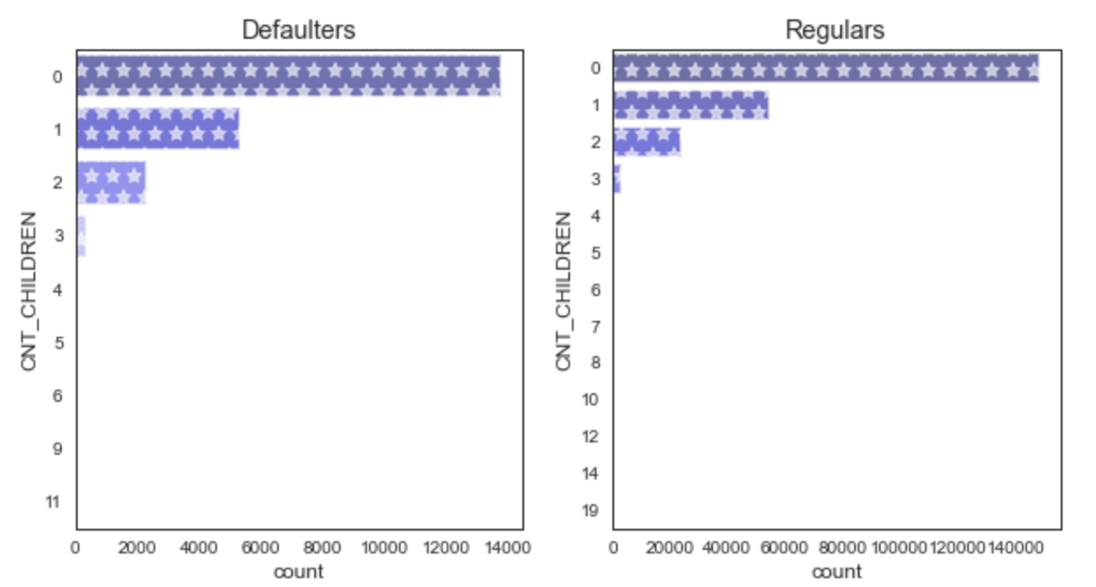
Univariate - Categorical Analysis for Clients with Children Count for both Defaulters and Regulars
There isn't much difference in children count of both the defaulter and regular list

Slide 31
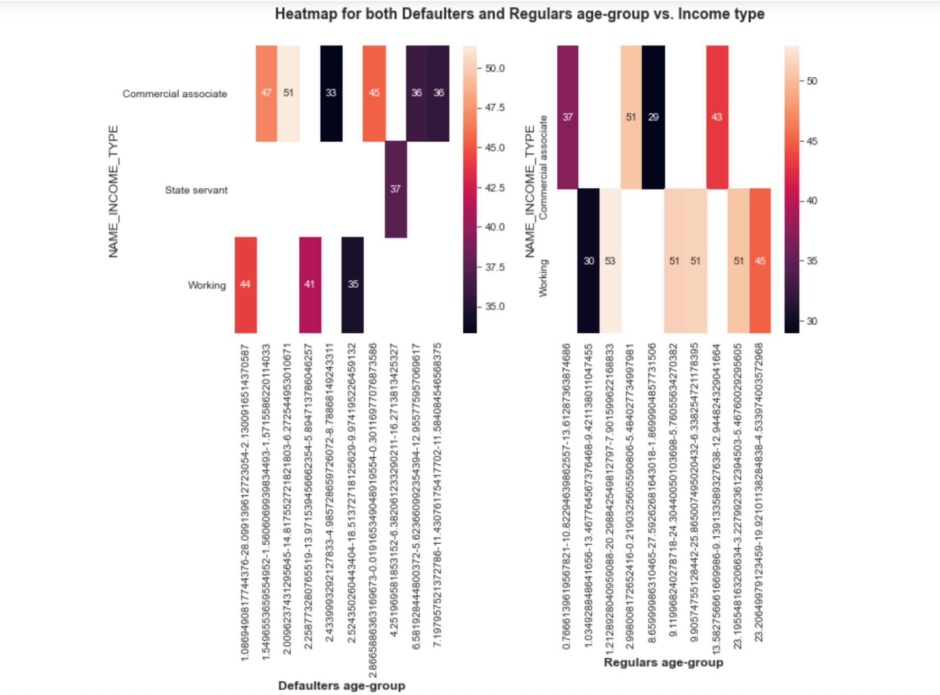
Segregation in both Defaulters and Regulars from the Income range
Age of defaulters with their Income
The clients who work with years of employed range less than 2.5 years with age more than 34 are defaulters
The commercial associates with years of employed upto 7 years with age more than 35 are defaulters
Age of regulars with their Income
The commercial associates with years of employed upto 13 years with age upto 50 are regulars

Slide 32
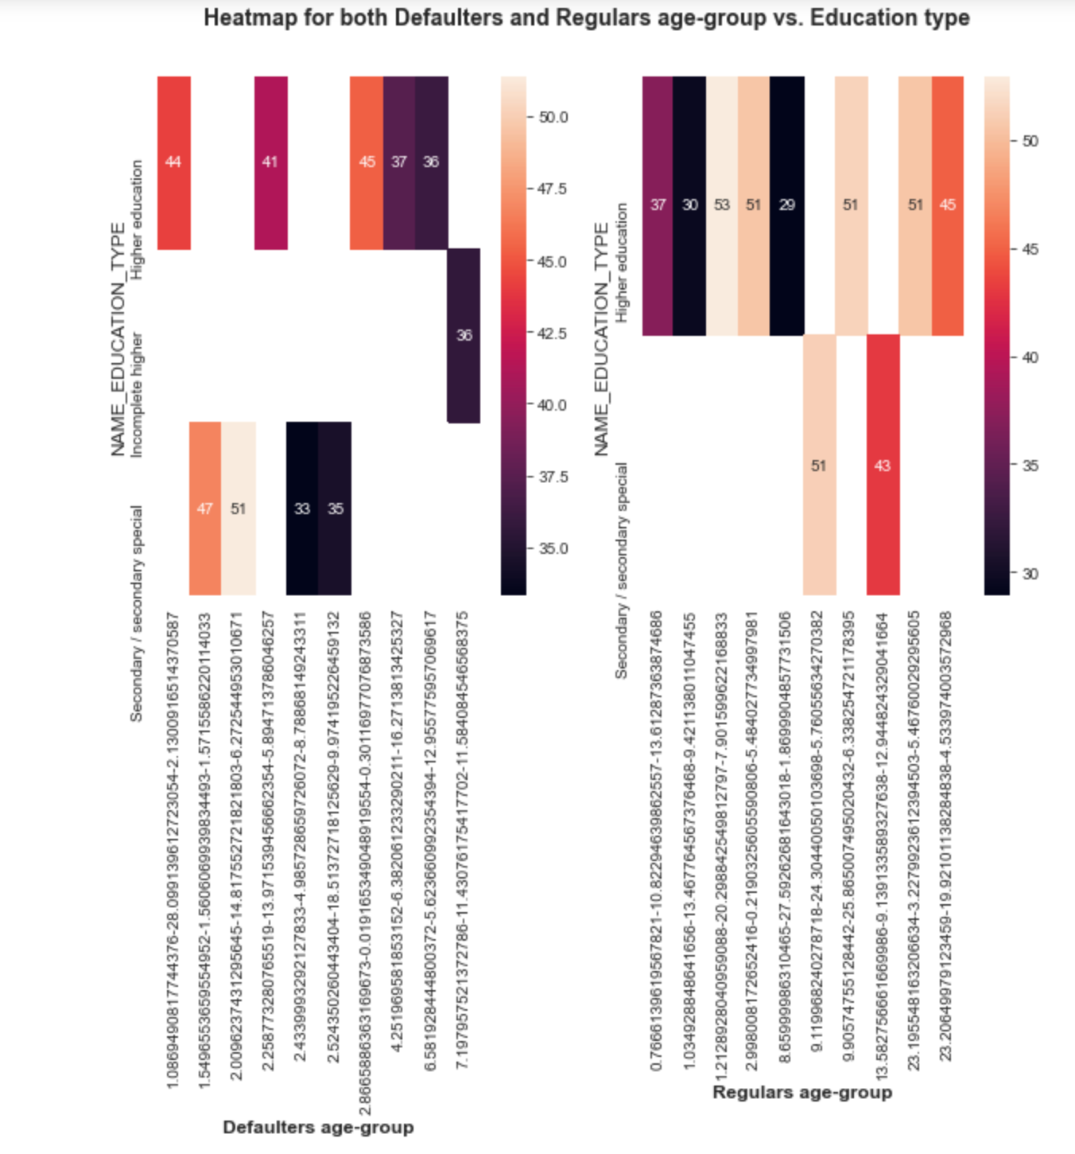
Pivot for top 10 Defaulter’s Income range with their Education Type
Age of defaulters with their Education
The clients who hold higher education status with age more than 35 are defaulters
The clients who hold secondary/secondary special education with age more than 33 are defaulters
Age of regulars with their Education
The clients who hold higher education status with age more than 28 and have years employed status higher are regulars
The clients who hold secondary/secondary special education with age more than 43 and have years employed status higher are regulars

Slide 33
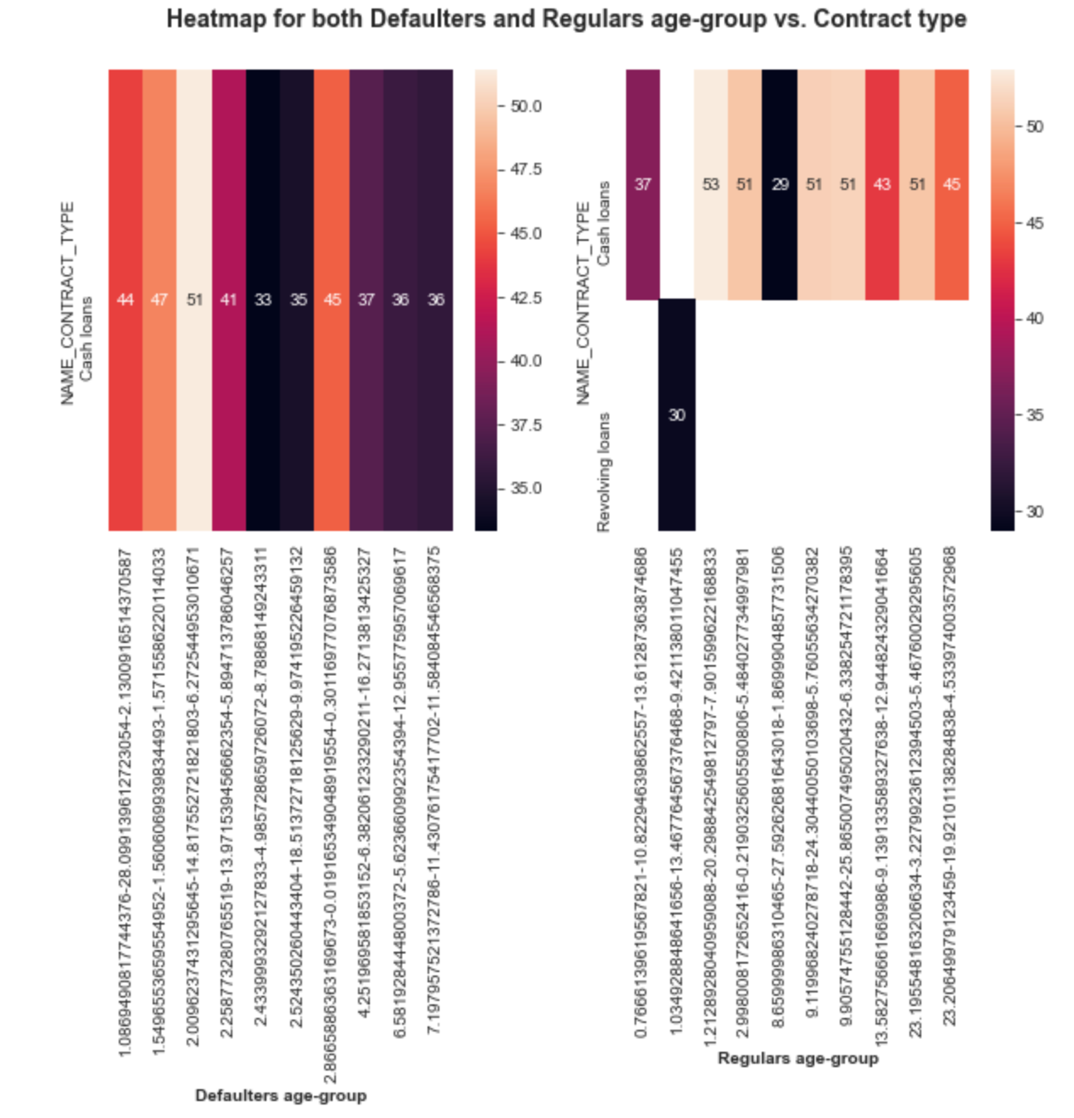
Pivot for top 10 Defaulter’s Income range with their Contract Type
Age of defaulters with Contract
The clients who avail cash loans are defaulters in general with age group more than 33, so there is a possibility with repayment delays
Age of regulars with Contract
The clients who avail cash loans are regular in general with age group more than 37
The clients with age less than 30 uses revolving loan and is regular in repayment

Slide 34
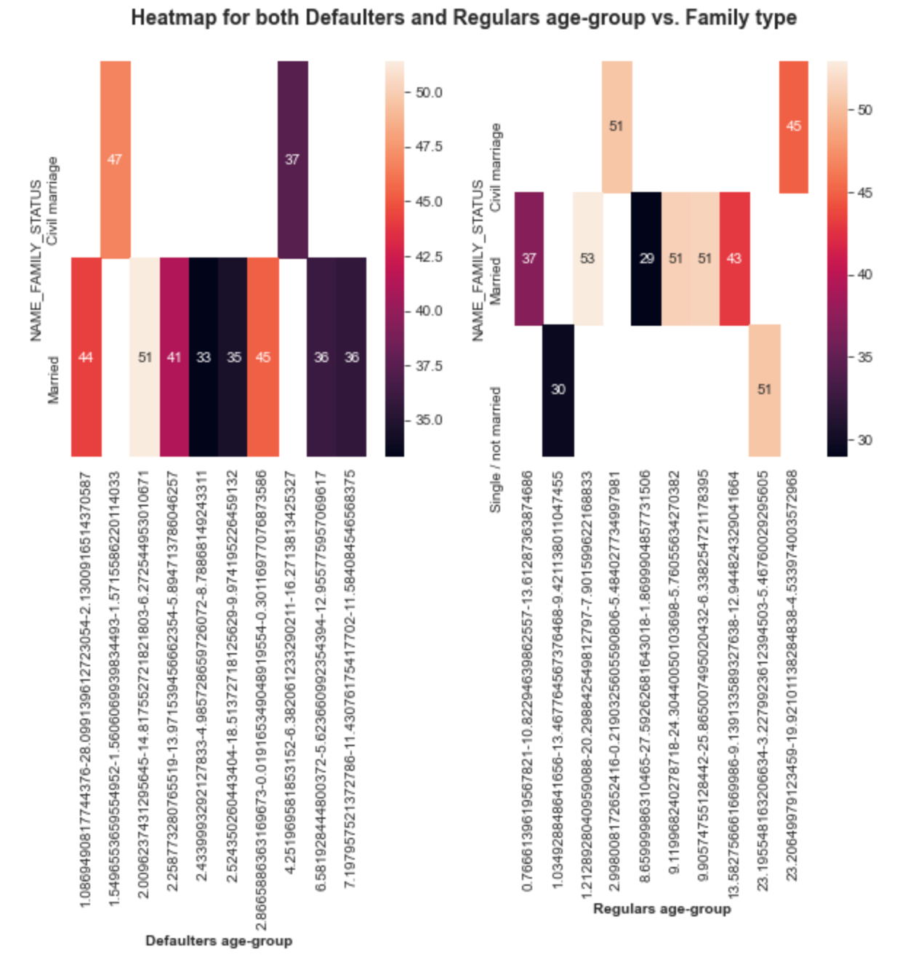
Pivot for top 10 Defaulter’s Income range with their Family Type
Age of defaulters with Family
The clients who got married are defaulters in general with age group more than 33, so there is a possibility with repayment delays due to family dependency
Civil married clients ranging more than 37 age group are listed as defaulters
Age of regulars with Family
The clients who got married are regulars in general with age group more than 37
Civil married clients ranging more than 44 age group are listed as regulars

Slide 35
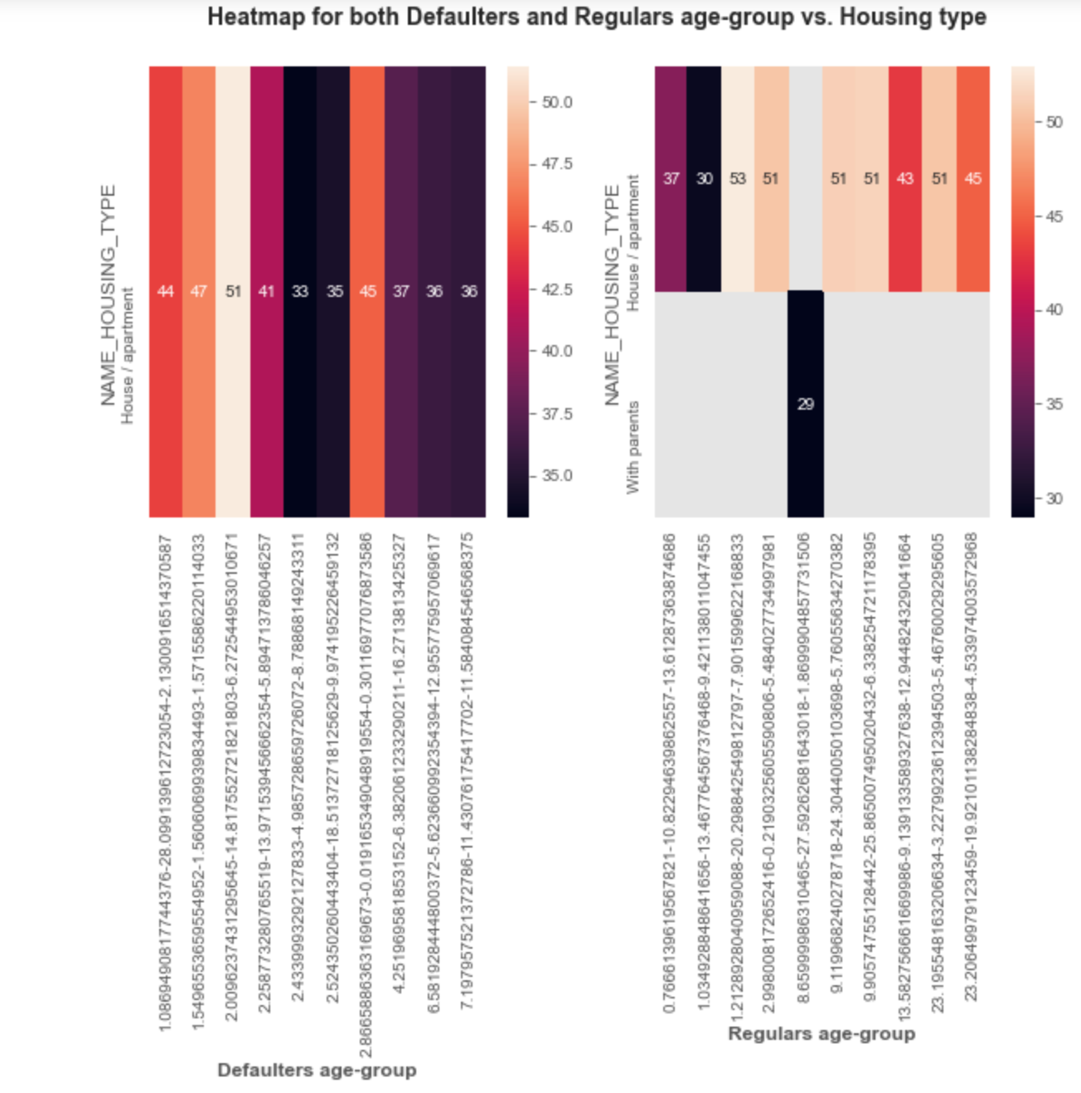
Pivot for top 10 Defaulter’s Income range with their Housing Type
Age of defaulters with Housing
The clients of housing / apartment type with age group more than 33-51 are defaulters
Age of regulars with Housing
The clients of housing / apartment type with age group more than 37-53 are regulars

Slide 36
PRE-APPLICATION
ANALYSIS

Slide 37
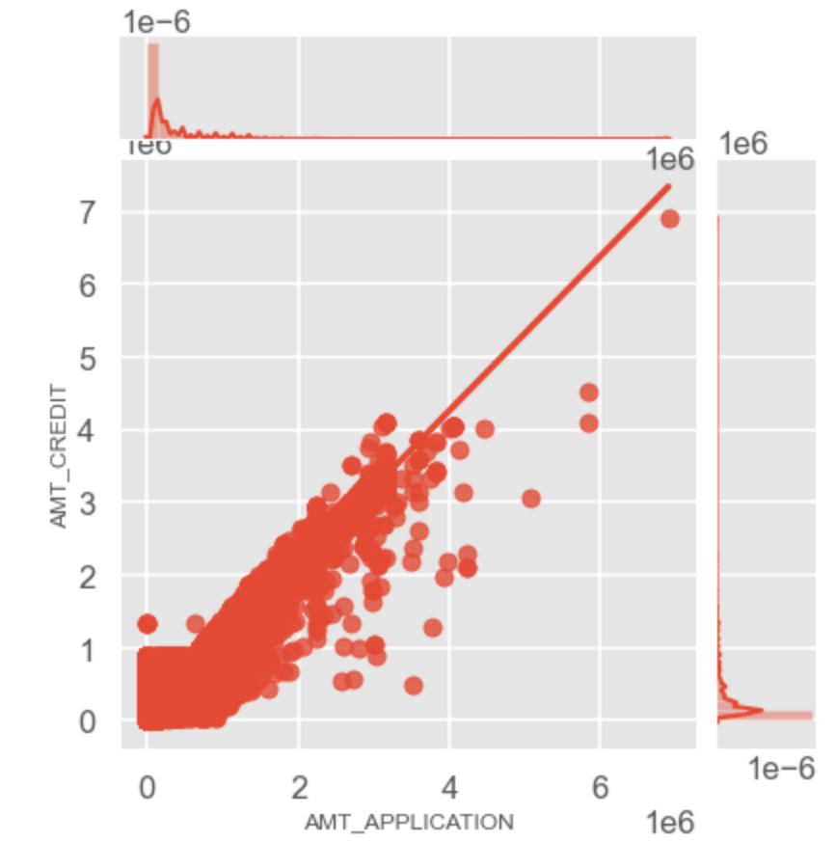
Plotting for Credit Amount vs Application Amount
We can see that there is linear relation between the Credit amount and the Application amount with certain outliers

Slide 38
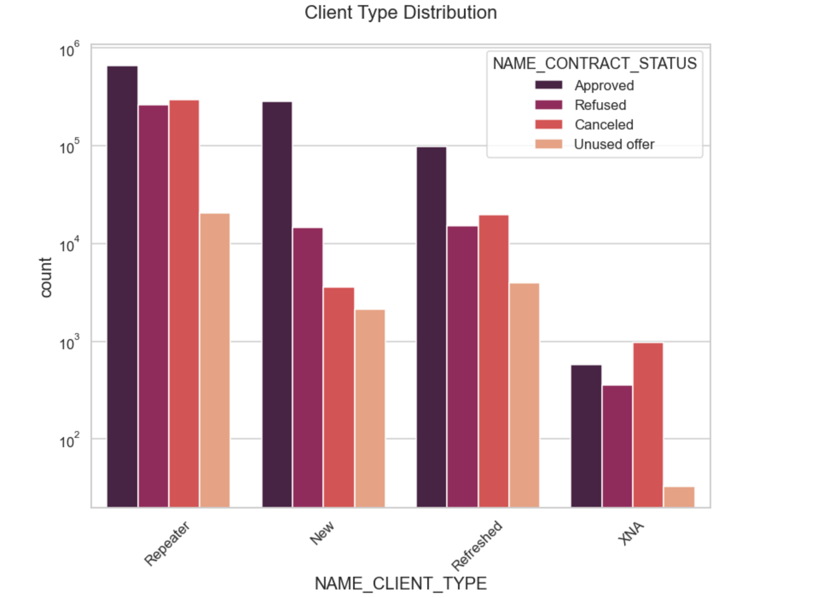
Plotting Client Type Distribution
We can infer that Repeaters have the highest number of Approval rates followed by new applications
Refreshed has the lowest number of applications

Slide 39
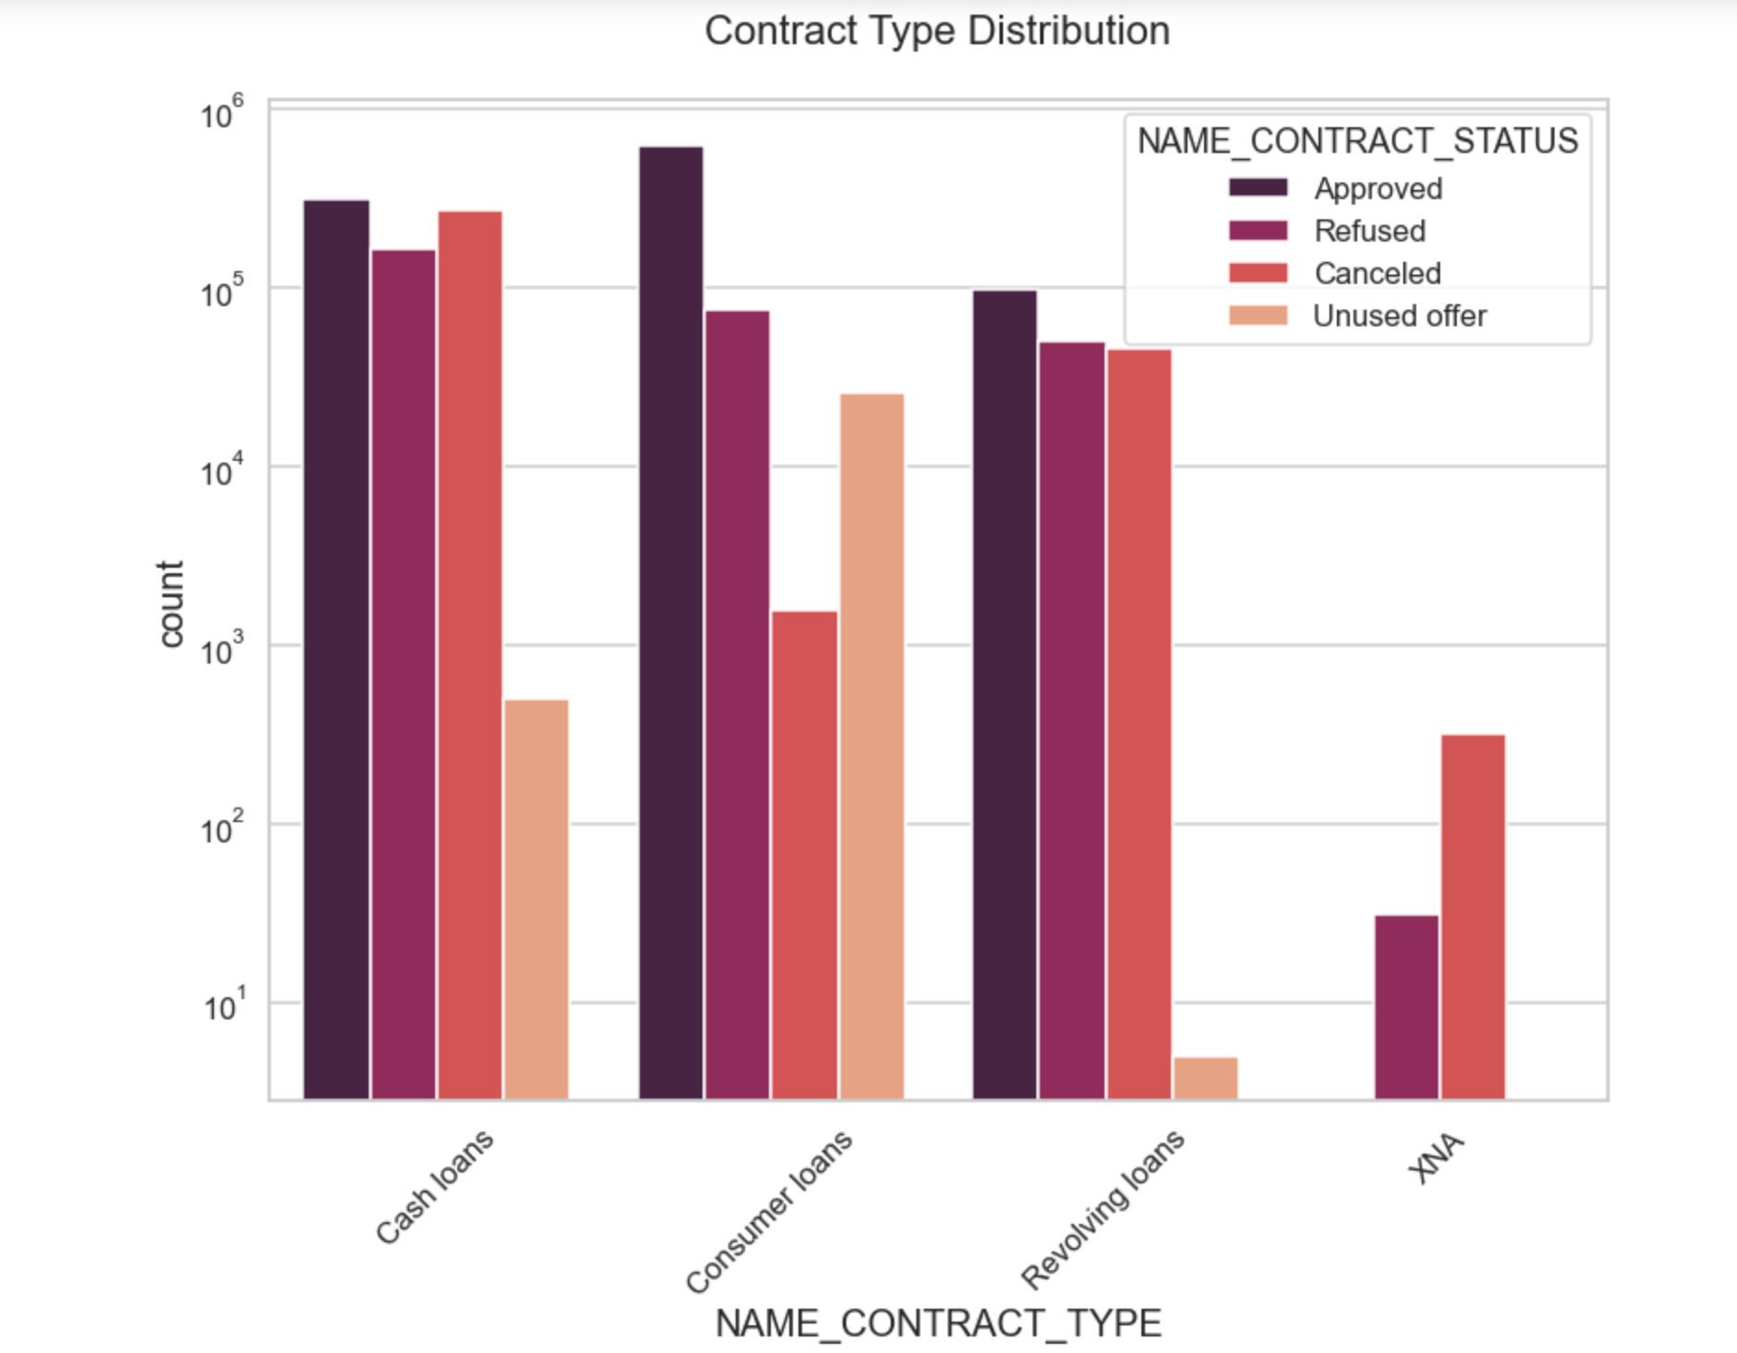
Plotting Contract Type Distribution
We can see that Consumer loans have the highest number of approvals followed by cash loans
Revolving loans are on a lower side as compared to the other two
Cash loans have the highest number of refusal and cancel rate when compared to others
Cash loans have the highest number of unused offers
Revolving loans have the lowest number of unused offer

Slide 40

CONCLUSIONS

Slide 41
CONCLUSION
The overall defaulters application count is lesser and people who have lesser income tend to become defaulters and there are delays in payment. The Bank's exposure looks safe as most of the people are regular payers on time. Defaulters will be there in every scenarios as not all humans are perfect and prone to emergencies, which might divulge their funds elsewhere. However these defaulter are not willful defaulters, just the ability to pay for that month is weak.
Females in general have applied for loans more than Males, also females have contributed more towards regular payments as well.
There is a drastic difference in regulars count with respect to gender as female applicants are twice as that of the male applications somewhat nearer 2:1 ratio. This shows that females are more reliable to loan out to other than males.
Aging influences people with various factors as most of the case study revolves around the age group between 35-50 years for most cases in both Regulars and Defaulters. This might be as people would have started their families in early 30's and the expenses keep on piling up and with inflation on the rise, the capita per income looks weak due to which most families are in need of apply for a credit for overhead expenses.
Some exceptions with defaulters with outliers where there are people who yield high income but these people should be businessmen who invest their earnings in other sources and that may lead to delay payment time. As lending to businesses are risky in general, lending to businessmen is more of a 'High Risk, High Reward' factor associated with it.

Slide 42
CONCLUSION
When there is dependency with family and realty the people are more prone to be regulars and people who are independent are defaulters. People tend to look after what's really important to them and are less likely to take risks with their credit since they have multiple mouths to feed incase something goes wrong however its quite opposite with independents as they to only to look over themselves, the risk factor increases.
Increase in age shows that most of the regulars fall in this incremental category. People get more wiser and less reckless as age gets the better of them and due to multiple responsibility, they are good and stable payers.
In Regulars the clients who own an apartment/flat are most likely to earn well and they fall under the category of Regulars due to the documents of REALTY they would have submitted during loan application also Regulars are majority in numbers
The people who got loan credit of 3.5 lakh to 5.6 lakh turns out to be defaulters as they might be students who are still studying or even looking for job. Clients who avail cash loans are defaulters in general with age group greater than 33 years, so there is a possibility with repayment delays

Slide 43


SUGGESTIONS

Slide 44
SUGGESTIONS
Banks should focus more on Females with steady and regular income.
Businessmen should be evaluated well with their Financial Statements over the past 3 years, to get a better idea of their business and their profit margins. Since most new businesses/start ups fail, banks should evaluate their projected income and assets and should give away loans in parts only if the targets are met as shown in the projections.
Banks should back applicants that are Home Owners Vs Rented Houses. Applicants with 1 child or living with parents should be targeted more often as they tend to be more reliable payers.
Banks should avail credit to applicants with Higher Education and Years of Employment status on a higher side who are 28 years and above. Also, applicants who hold Secondary/Secondary Special Education with Years of Employment higher who are 43 years and above.
Banks should focus more on Consumer Loans as compared to Cash Loans as they are more defaulted in most cases.
Banks should be cautious while giving out small and medium size loans to Students with Irregular Income as they are still exploring options for Job opportunities due to which they might default more.

Slide 45


